Slide 1
LMG Data council overvieW
Sheila Cameron – October 2022

Slide 2
STRUCTURE
LMG Board
(Members: LMA, IUA, LIIBA, Lloyd’s)
Data Council
Technical Group

Slide 3
Data council - purpose
1. Drive digitisation of the London Market through a commitment to using standardised and high quality data between all market participants and their clients.
2. Drive adoption of:
Data standards in conjunction with ACORD
Open market risk Core Data Records
Computable contracts
Data assembly process, including roles and responsibilities
API standards

Slide 4
Guiding principleS
The customer’s needs will be prioritised over that of market participants
We will embrace and enhance global data standards and remain aligned to them
We will drive data assembly solutions that benefit the London Market as a whole and improve the ease of doing business with the London Market, accepting that may mean we need to make compromises within our own firms.
We will adopt an 80/20 approach where appropriate, acknowledging that we cannot solve for all situations.
A data first approach forms the backbone of our strategy, but in recognition of the starting position of the majority, transition paths will be created to allow gradual adoption. However, we will not move at the pace of the slowest adopter.
We will not support adoption transition paths forever, and there is an expectation that at some point (within a reasonable timeframe) everyone will make the investments to move forward
The achievement of our objectives is expected to enable further digital innovation and differentiation across market firms, with the Data Council focused on defining areas that firms cannot individually determine themselves, akin to a Highway Code.

Slide 5
Standards & Core data record
The CDR lays out the business requirements of data that is required for processing by the bureau. It is a digital representation of the following 4 areas: tax validation and calculation, regulatory reporting, claims matching and accounting & settlement
Open Market CDR Purpose
Lloyd’s Only
Tax validation & calculation
…validate taxes, enabling tax certainty earlier in the process.
Regulatory reporting
…satisfy regulatory and supervisory functions, keeping licenses in place without inefficient queries, and automating reporting encoding (e.g. FIL code)
Company & Lloyd’s Market
Claims matching
…match First Notice of Loss to the relevant Market Reform Contract and identify the claim agreement parties.
Accounting & settlement
…reconcile technical and financial accounts, allowing funds to be settled automatically.
Global Risk and Large Commercial (GRLC) standard
Global Risk and Large Commercial (GRLC) standard

Slide 6
Standards & Core data record
The most complex risk we can come up with…..
… is a risk with a Spanish commercial policyholder, using two intermediaries (one in Germany and one in Denmark), who are responsible for one or more taxes. These intermediaries are paid commission, and they’re shipping cargo registered in Germany with Lloyd’s of London, LIC and company market participation, including a pool with additional insureds in Portugal, with multiple taxes, fees and discounts, multiple instalments for an adjustable premium, with a different settlement currency. This would take approx. 144 CDR fields and most likely would be handled outside the automated processes.
Composition of the CDR v3.1
CRD Fields | Lloyd’s or dual market | Company Market only
Total CDR fields | 199 | 115
Mandatory Fields (A fields) at bind | 43 | 35
Conditional / mandatory (A fields) at bind | 94 | 52
Enriched (B fields) | 21 | 9
Most simple (complex) risk field counts | 61 (144) | 53 (93)
Average | 125 | 95
The most simple risk we can come up with…..
… is a single French property fac risk with no associated taxes, deductibles, fees, discounts or commissions. This applies to both the company market (53 CDR fields) and Lloyd’s market (61 CDR fields).
By comparison, buying one item on Amazon require ~30 fields.

Slide 7
Computable CONTRACTs
* TPPP = Third party placing platform such as PPL or Whitespace
A computable contract is a contract that uses standardized and structured natural language that can be easily understood by both humans and machines.
The CDR must be delivered via a computable contract. There are three pathways to a computable contract:
Document to data route
Data first routes
1. IMRC to TPPP* to OCR
2. Data to TPPP
3. Broker/Carrier Direct API
Document
TPPP OCR/ AI
Data
API
Broker
Carrier
Data
API
Gateway
Gateway
API
TPPP
API
TPPP
The CDR is then submitted via one of the above pathways via API only to the DXC Gateway.
Gateway

Slide 8
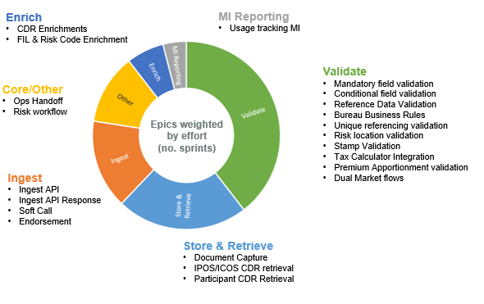
DXC Gateway – what is it?

Slide 9
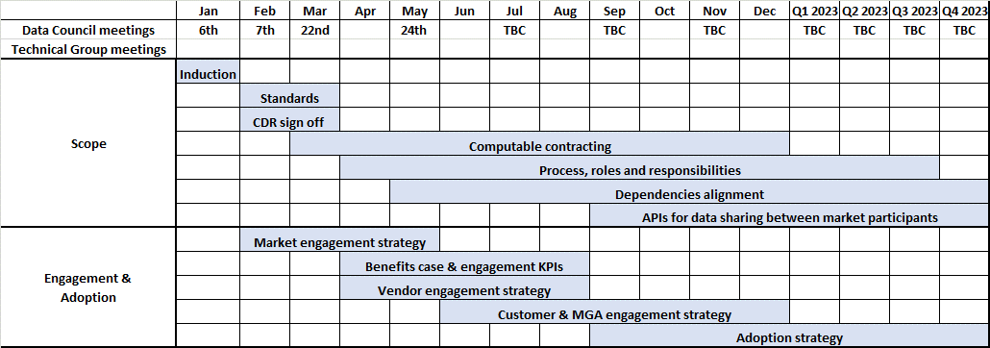
2022 High level MILESTONE plan

Slide 10
2023 high level plan
Q1
Q2
Q3
Q4
CDR & Standards
Approve and publish final ACORD aligned CDR
Agree DA data standards
Agree claims data standards
Computable Contracts
Approve and publish MRC v3.0 Commence MRC v3.0
adoption
MRC endorsements and MRC v3.0 “back pages”
Possible guidance for data first computable contract (TBC)
Process, Roles & responsibilities
Process consultation
Define process for endorsements, errors & failures
Publication of open market process post consultation
Agree DA process
Agree claims process
APIs
Review of approach to API publication & integration
Accreditation approach to access API’s to / from the JV
External Dependencies
PPL agreement to adopt
API Publications from JV
JV build complete (Gateway/IPOS/ICOS) - Note MAT to follow and Roll-out

Slide 11
LMG Board
LMG Data Council
Technical Group
Chair: Jonathan Prinn
Standards & CDR
Chair: Kirstin Duffield
Computable Contracts and CDR capture methodology
Chair: Justin Emrich (Atrium)
Process Flows, Roles & Responsibilities
Joint Chairs: Rob Myers (LMA) & Helen Howard Knight (Aon)
Review propose changes to the CDR that have request from other business areas
Work with ACORD to create updated version of CDR and implementation guidance.
Ensure the Core Data Record accurately reflects the contract and is understood by all parties to the contract.
Promote a single ACORD data standard that enables the extraction of the Core Data Record (CDR).
Support the ACORD Business Implementation Group in aligning the CDR to ACORD standards.
Agree and recommend process and responsible parties for CDR assembly and submission, incl. correction loops
Seek acceptance on the recommendations by the Data Council
Provide approved definitions of process, roles and responsibilities to GDAC
X Workstream Group
Chair: Cassandra Vukorep
Analyse identified recommendations within each one of the technical group
Discuss the best way forward on recommendations and feed details back to independent group
Map CDR against ACORD standard
Act as a channel of communication change across the technical group

Slide 12
APPENDIX - Record of key decisions made
ACTIONS
1 | Approved ACORD’s GRLC standard as our data standards methodology and support its market wide adoption. | March 2022 meeting
2 | Approved content of CDR as agreed by March 2022 Technical Group. | March 2022 meeting
3 | Approved commencement of MRC v3 consultation process | May 2022 meeting
4 | Agreed to focus benefits on articulation of end vision rather than detailed annualised benefits. | May 2022 meeting
4 | Agreed the design principles as a sound basis for commencing detail process design work, recognising that the detailed definition work will validate these further. | July 2022 meeting
5 | Approved ACORD’s LIP community as the method for engaging with the software vendor community. | July 2022 meeting
6 | Agreed to delay DA and claims CDR to later in 2023 | September 2022 meeting

